Slide 1
Quench and Trapped Flux Studies at Cornell
Dan Gonnella
Advisor: Matthias Liepe

Slide 2
Outline
Temperature Mapping System Hardware
T-Maps Before Quench
T-Maps After Quench
Quench Detection with T-Map Hardware

Slide 3
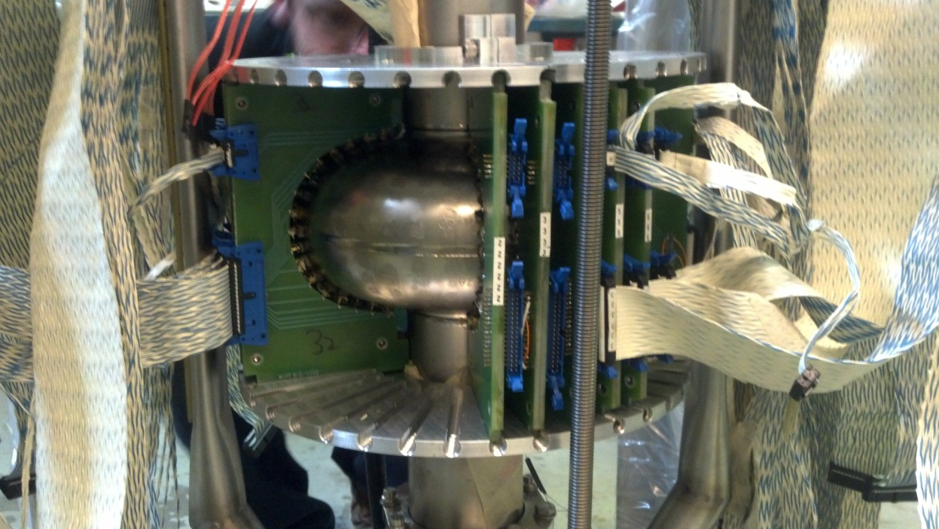
Temperature Mapping System
A Temperature Mapping system was developed consisting of 646 resistors.
This allows us to obtain a full temperature profile of the cavity during testing.

Slide 4
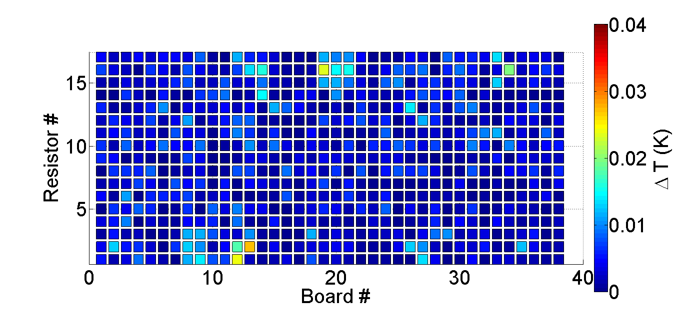
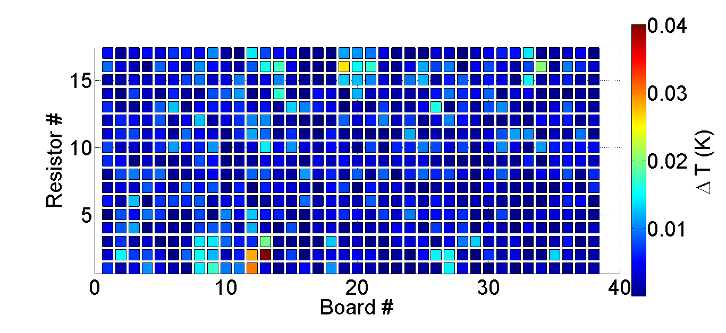
T-Maps Before Quench
Prior to quench, the cavity is dominated by heating at two hotspots.
2
36 MV/m
1
37 MV/m

Slide 5
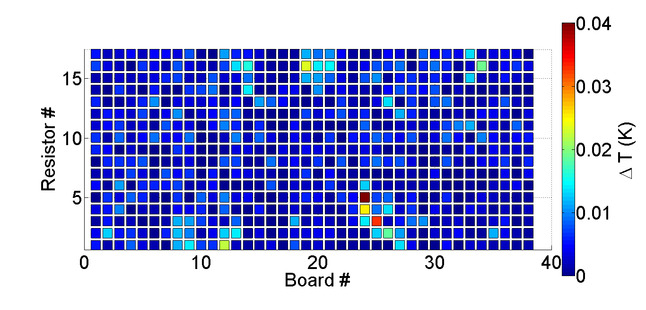
T-Maps After Quench
Immediately after quench the previous hot spots remain, but a new one, with more dominant heating appears.
After Quench
3
36 MV/m
Before Quench

Slide 6
Interpretation of Post Quench Heating
After a quench, new heating appears in region “3”, where previously no significant heating was found.
This hot spot remains for all subsequent T-Maps until a thermal cycle is performed.
This new heating may be the manifestation of trapped magnetic flux in the region.

Slide 7
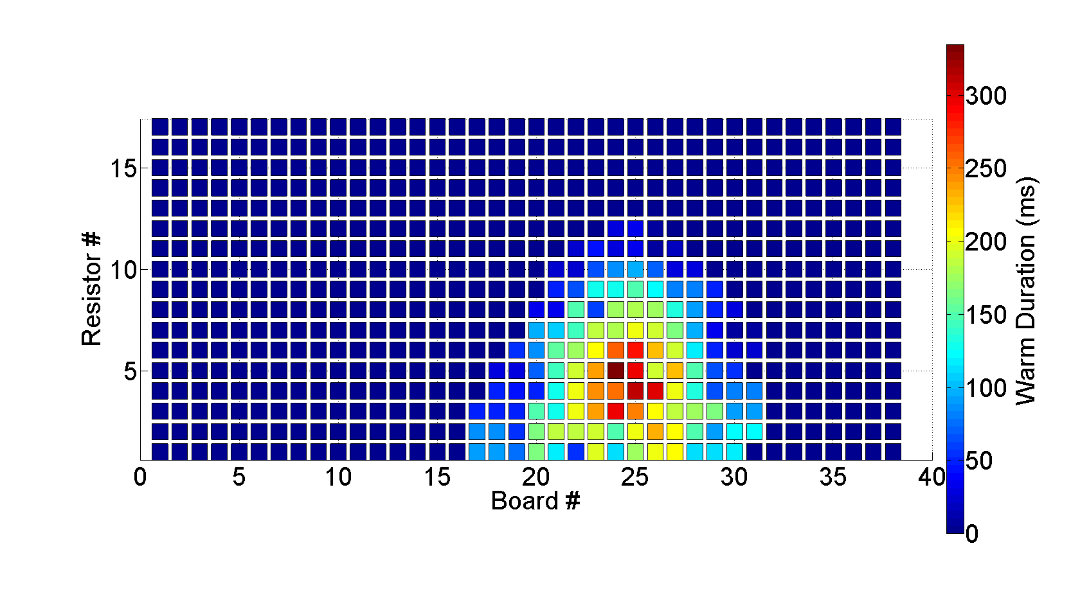
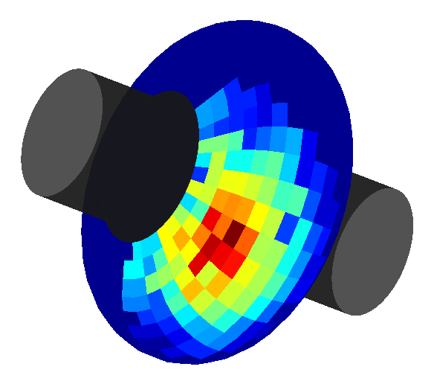
Quench Detection
The quench location was also found using the T-Map system.
The quench location was found to be centered at location “3”.

Slide 8
Pre-Quench Heating and Quench Location
Prior to quench, no significant heating appears at the quench location.
This implies that the quench is not caused by heating on the surface.
The quench was caused by the sudden transition of region “3” to the normal conducting state.

Slide 9
Possible Causes of Quench
The sudden transition from the superconducting state to normal conducting state may be caused by:
Region “3” being a region of suppressed superconductivity.
Magnetic field enhancement caused by surface topology.

Slide 10
Conclusions
Prior to quenching, heating is confined to two hot spots.
After quench, a new, dominant hot spot appears. This spot is also the center of the quench location.
This suggests that magnetic flux is being trapped in region “3” and showing up as heating in subsequent t-maps.

